Slide 1
CycleGAN with Feature-Consistency Loss
曾昊 2019233139
张秀珍 2019233141
连新远 2019232092

Slide 2
Outline
Background
Improved CycleGAN
Imbalanced size of datasets
Conclusion

Slide 3
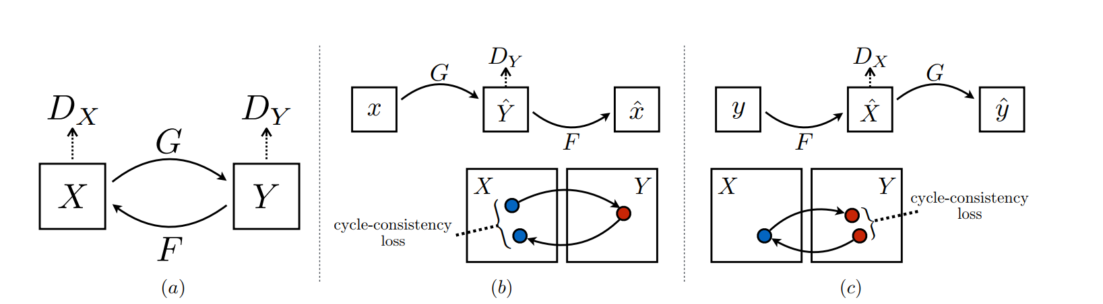
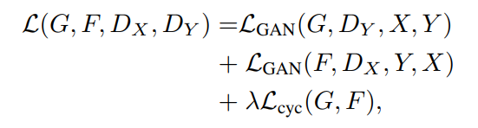
CycleGAN

Slide 4
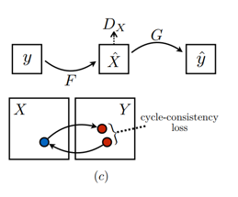
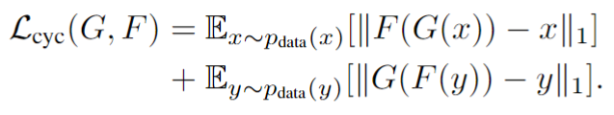

Cycle Consistency Loss
Mapping from style 1 to style 2 and back again should give you almost the original image
Learn color/texture mapping
Pixel level
Prevent mode collapse

Slide 5
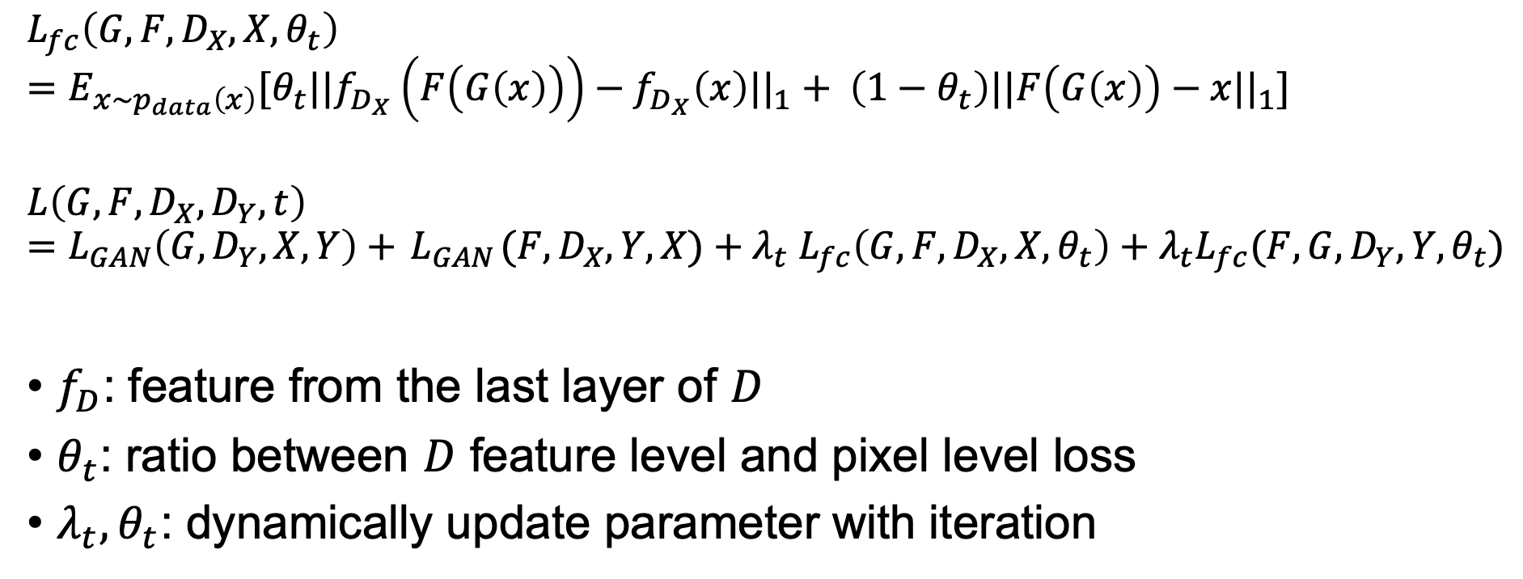
Improved cycle consistency loss
$$L_{fc}\left(G,F,D_{X},X,θ_{t}\right)=E_{x\sim p_{data}\left(x\right)}[θ_{t}||f_{D_{X}}\left(F\left(G\left(x\right)\right)\right)−f_{D_{X}}\left(x\right)||_{1}+ \left(1−θ_{t}\right)||F\left(G\left(x\right)\right)−x||_{1}]$$
$$L\left(G,F,D_{X},D_{Y},t\right)=L_{GAN}\left(G,D_{Y},X,Y\right)+{ L}_{GAN}(F,D_{X},Y,X){+ λ}_{t}L_{fc}\left(G,F,D_{X},X,θ_{t}\right)+λ_{t}L_{fc}(F,G,D_{Y},Y,θ_{t})$$
$f_{D}$: feature from the last layer of $D$
$θ_{t}$: ratio between $D$ feature level and pixel level loss
$λ_{t}, θ_{t}$: dynamically update parameter with iteration

Slide 6
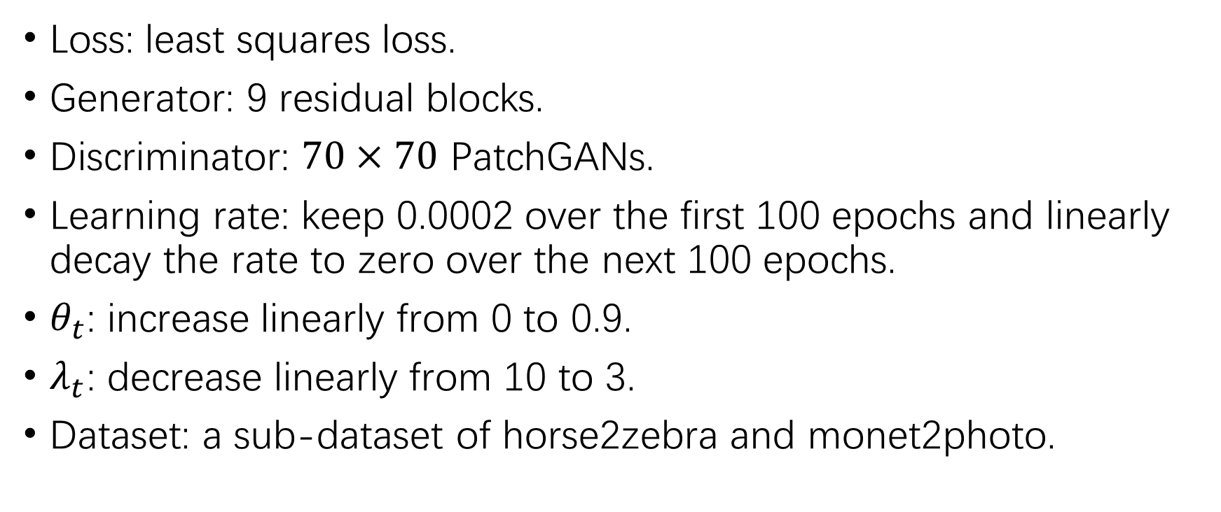
Training details
Loss: least squares loss.
Generator: 9 residual blocks.
Discriminator: $70×70$ PatchGANs.
Learning rate: keep 0.0002 over the first 100 epochs and linearly decay the rate to zero over the next 100 epochs.
$θ_{t}$: increase linearly from 0 to 0.9.
$λ_{t}$: decrease linearly from 10 to 3.
Dataset: a sub-dataset of horse2zebra and monet2photo.

Slide 7
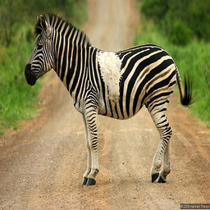
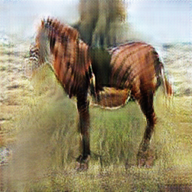
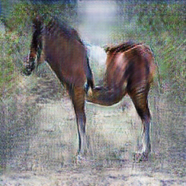
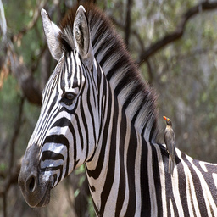
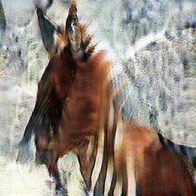
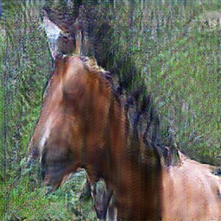
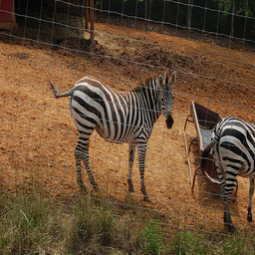
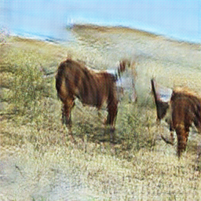
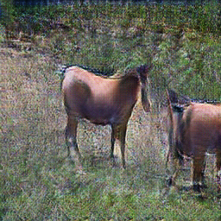
Experiments
Input
CycleGAN
Ours

Slide 8
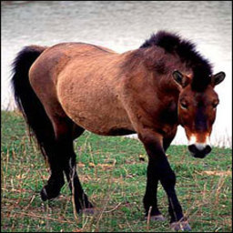
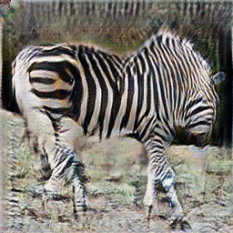
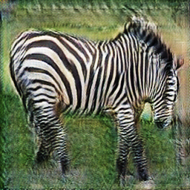
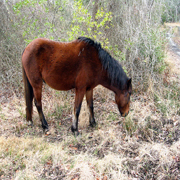
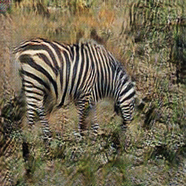
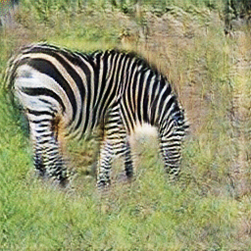
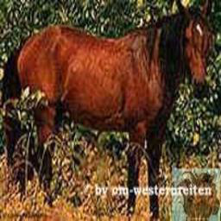
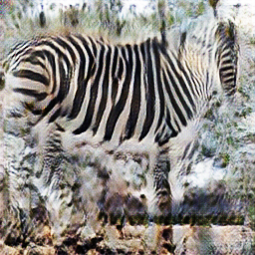
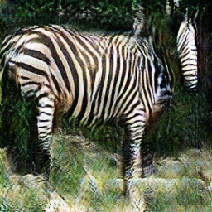
Experiments
Input
CycleGAN
Ours

Slide 9
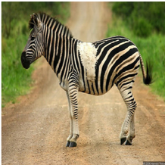
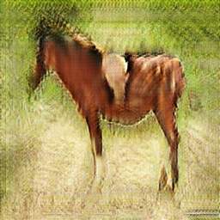
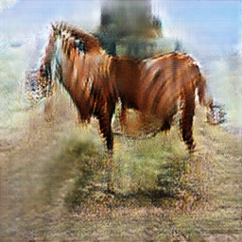
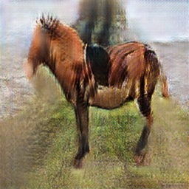
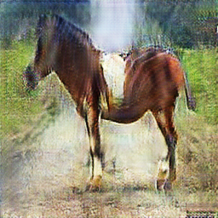
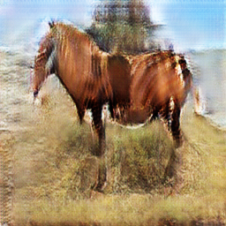
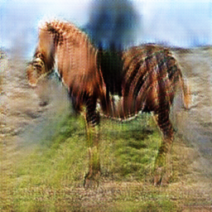
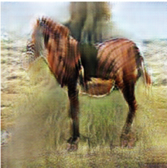
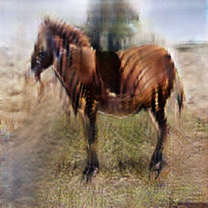
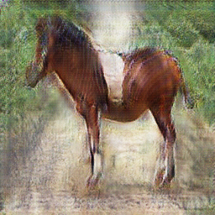
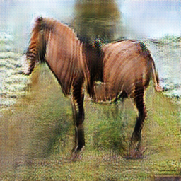
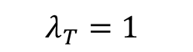
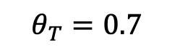
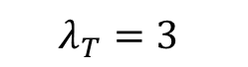
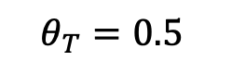
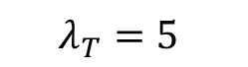
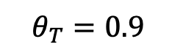
Parameter tuning results
$$θ_{T}=0.5$$
Input
$$θ_{T}=0.7$$
$$θ_{T}=0.9$$
CycleGAN
$$λ_{T}=1$$
$$λ_{T}=3$$
$$λ_{T}=5$$

Slide 10
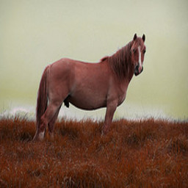
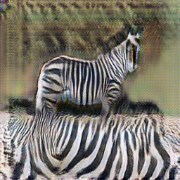
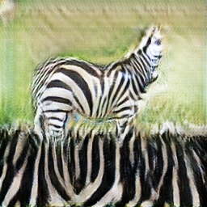
Failure case
Input
CycleGAN
Ours

Slide 11


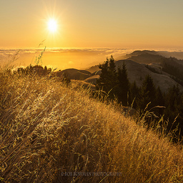
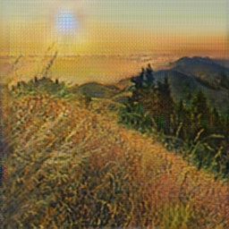
Imbalanced size of datasets
100-100 CycleGAN
Input

Slide 12
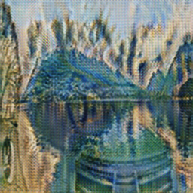
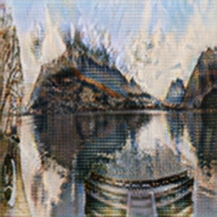
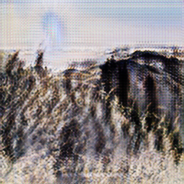
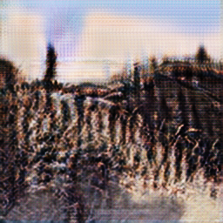

Imbalanced size of datasets
100-100 CycleGAN
10-100 CycleGAN
$SinGAN×$10-100 CycleGAN
Input

Slide 13

Conclusion
The feature-consistency loss help to capture details.
CycleGAN with $L_{fc}$ performs better
Fewer improvement on imbalanced size of datasets

Slide 14

Reference

Slide 15
Thanks
Q&A

